Slide 1
Issues in the NAFTA Renegotiation
Alan V. Deardorff
University of Michigan
For Tuesday Lunch
November 28, 2017

Slide 2
Outline
NAFTA
What it is
What have been its effects
Renegotiation
Timeline
Issues
Autos
Prospects

Slide 3
NAFTA Renegotiation
Donald Trump
Trump opposed NAFTA as early as 1993
“The Mexicans want it, and that doesn't sound good to me.”
As candidate in 2016
“The single worst trade deal ever approved in this country”
As President
April 26: Threatened to pull out of NAFTA completely
April 27: Decided not to, and to renegotiate instead
May 18: Formally launched renegotiation

Slide 4
NAFTA Renegotiation
August 16: Negotiations began
Round 1: Aug 16-20, Washington, D.C.
Round 2: Sep 1-5, Mexico City
Round 3: Sep 23-27, Ottawa
Round 4: Oct 11-15, Washington, D.C.
Round 5: Nov 17-21, Mexico City
Round 6: Dec ?-?, Washington, D.C.
(Meeting without the principals, who will meet next in late January in Montreal)

Slide 5
Renegotiation Issues
Issues (US)
Trade imbalances
Reciprocal duty-free market access
Rules of origin
Regulations
Services
Digital trade
ISDS
State-owned enterprises
Labor standards
Chapter 19
Procurement
Currency manipulation

Slide 6
Renegotiation Issues
Issues (US)
Trade imbalances
Reciprocal duty-free market access
Rules of origin
Regulations
Services
Digital trade
ISDS
State-owned enterprises
Labor standards
Chapter 19
Procurement
Currency manipulation

Slide 7
Renegotiation Issues
Other Issues (Canada)
Gender rights
Indigenous rights
Freer movement of professionals
Dairy & poultry
Cultural exemptions

Slide 8
Renegotiation Issues
Other Issues (Mexico)
Avoid increased US tariffs on Mexico’s exports (80% of Mexico’s exports are to the US)
Anti-corruption
Energy, financial services and telecommunications
Guest worker program in US

Slide 9
Renegotiation Issues
US New Demands
Sunset clause
NAFTA should expire after 5 years if not renewed
Seasonal restrictions on imports

Slide 10
Issues in More Detail
Trade imbalances
The US top priority is to “Improve the U.S. trade balance and reduce the trade deficit with the NAFTA countries.”
Possibility: “trigger mechanism” that raises tariffs if goal of reducing deficit is not met
Most economists agree that trade deficits
Are not the result of trade policies
Don’t mean deficit country is losing
Result from spending more than income

Slide 11
Issues in More Detail
Rules of origin
USTR Lighthizer wants “higher NAFTA content and substantial American content”. That would be unprecedented in an FTA
Raise auto ROO from 62.5% to 85%
Also require 50% US content
Higher ROO will disrupt supply chains that have grown across NAFTA countries, especially autos
If too high, some producers will revert to sourcing from outside NAFTA

Slide 12
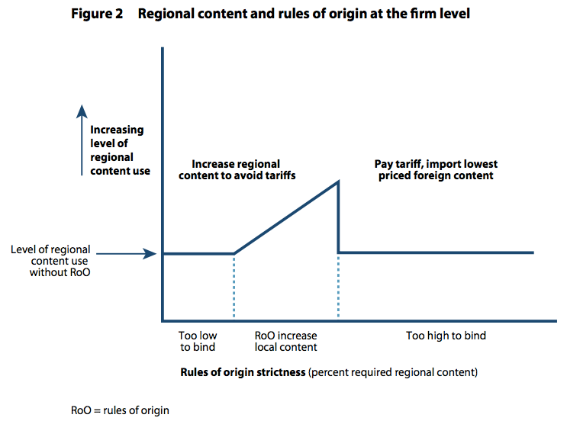
How Tighter Rules of Origin Can Increase Imports
From: Freund, Caroline, “Streamlining Rules of Origin,” Policy Brief 17-25, Peterson Institute for International Economics, June 2017.

Slide 13
Issues in More Detail
ISDS = Investor-State Dispute Settlement (Chapter 11 of NAFTA)
U.S. has so far never lost an ISDS case
Trump seems to want it retained (as do US large corporations)
USTR wants to eliminate it (as does the AFL/CIO)

Slide 14
Issues in More Detail
Chapter 19
This now allows NAFTA countries an appeal against AD & CVD actions
Canada insists on keeping it
US wants it removed
You can see why from the data below

Slide 15
Issues in More Detail

Slide 16
Issues in More Detail

Slide 17
Issues in More Detail
Dairy & poultry
Canada wants to keep its “supply management system for dairy and poultry”
Supply management allows farmers to act collectively to manage supply and price
Canada has a 270% tariff on dairy imports (with a small quota tariff-free)
This was exempted from liberalization in NAFTA

Slide 18
Renegotiation Prospects
US has included demands that some say are “poison pills”
Demands that they know others cannot accept
Is the purpose to get a better outcome (as they view it) for US?
Or is the purpose to justify later pulling out of NAFTA?

Slide 19
Renegotiation Prospects
One thing I will confidently predict:
The negotiations will be extended over time
That has already begun, with the delay of Round 5
It is what has happened repeatedly with other trade negotiations
Agreement will become harder, not easier as
US approaches mid-term elections
Mexico has presidential election

